Slide 1


Exness Partner Workshop
Leveraging AI for
Business Growth
in Ghana
Sena Quashie | 3 October 2026 | Accra

Slide 2
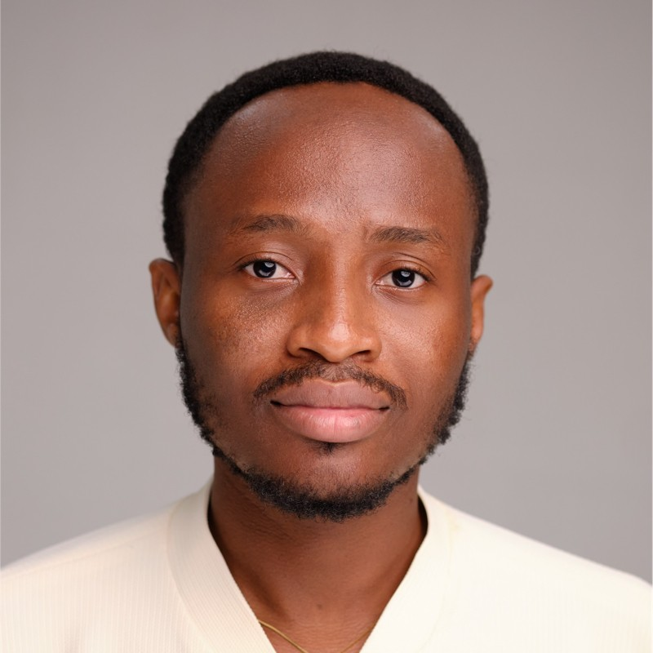
hello, there
SENA QUASHIE | Digital & Revenue Growth
I help boost business top-line by optimizing growth strategies, marketing, pricing, and sales, particularly in the digital realm. I help people turn attention into a business. Today that means you — Exness partners who already have an audience and need the engine behind it.
Currently I run wms, a company focused on making digital innovation easy to access for all businesses, and I also serve as Chief Digital Officer & ExCo at Media General and General Manager of one of the portfolio companies, where I lead the charge in digital strategy and execution across the group's diverse portfolio.
say hi sena@wms.africa
This is a working session. Phones out for polls and builds. If you leave with notes only, the day failed. By close you should have systems, not a nicer notebook.
WaterMeetSky · Exness Partner Workshop · Part 1
1

Slide 3
Opening scenario
A prospect messages at 11:47pm
By morning, the question has an answer.
The lead has a record and a clear next step.
AI understands the enquiry.
The Partner API checks available status.
The workflow remembers what happens next.
The room follows one person through the whole journey.
WaterMeetSky · Exness Partner Workshop · Client journey
J1
Notes:
Ask the room what usually happens to an enquiry arriving after they close for the day. Open the Journey Lab and start with Ama. Show the welcome, three qualification questions, and permission boundary. Explain that automatic replies can answer an inbound enquiry, while ongoing marketing contact needs the appropriate permission. Workshop hub: https://workshop.wms.africa/journey . Samples are fictional. The browser uses saved, reviewed AI outputs; /journey CASE uses live AI privately for the partner. The downloadable follow-up flows end in review, not automatic customer broadcasts. Preserve the complete existing teaching block that follows.

Slide 4
Today
What this day is for
The objective
Run the partner business like a structured operation — not more posting.
The method
We build live. You leave with templates you can use on Monday.
The outcome
A repeatable way to attract, capture, convert and retain using AI.
What this is not
A theory session about artificial intelligence. If it is not usable today, it stays off the slide.
WaterMeetSky · Exness Partner Workshop · Part 1
2
Notes:
Keep this crisp. Two minutes maximum.

Slide 5
Partner business
Where this journey earns its place
DA: appropriate prospects complete the
steps required for a qualifying referral.
Measure approved rewards against cost.
IB: useful ongoing support helps sustain
client relationships around trading.
Measure commission and service cost.
Client deposits, partner rewards and business profit are different figures.
WaterMeetSky · Exness Partner Workshop · Client journey
J2
Notes:
Exness pays DAs under CPA rules when new referred clients meet applicable deposit and activity requirements. IB remuneration follows eligible trading and depends on account type, instrument and partner level. No earnings improvement is guaranteed. The workshop tests how better onboarding and support affect outcomes. Source: https://get.exness-affiliates.help/hc/en-us/articles/360016522379-What-are-the-Exness-Partner-programs-available . Specific Standard calculation: https://get.exness-affiliates.help/hc/en-us/articles/360010858660-How-is-Standard-accounts-commission-calculated . Raw/Zero: https://get.exness-affiliates.help/hc/en-us/articles/360010855900-How-is-Zero-and-Raw-Spread-commission-calculated . Workshop hub: https://workshop.wms.africa/journey . Samples are fictional. The browser uses saved, reviewed AI outputs; /journey CASE uses live AI privately for the partner. The downloadable follow-up flows end in review, not automatic customer broadcasts. Preserve the complete existing teaching block that follows.

Slide 6
Today
How the day runs
Morning
The Engine
Positioning, brand, content, social growth
15 min
Break
Then we come back to capture
Late morning
Capture
Lead generation, data, a working CRM
60 min
Lunch
Phones down. Systems stay open.
Afternoon
Convert & keep
Follow-up, verification, community, retention
Close
Apply
Group challenge
WaterMeetSky · Exness Partner Workshop · Part 1
3

Slide 7
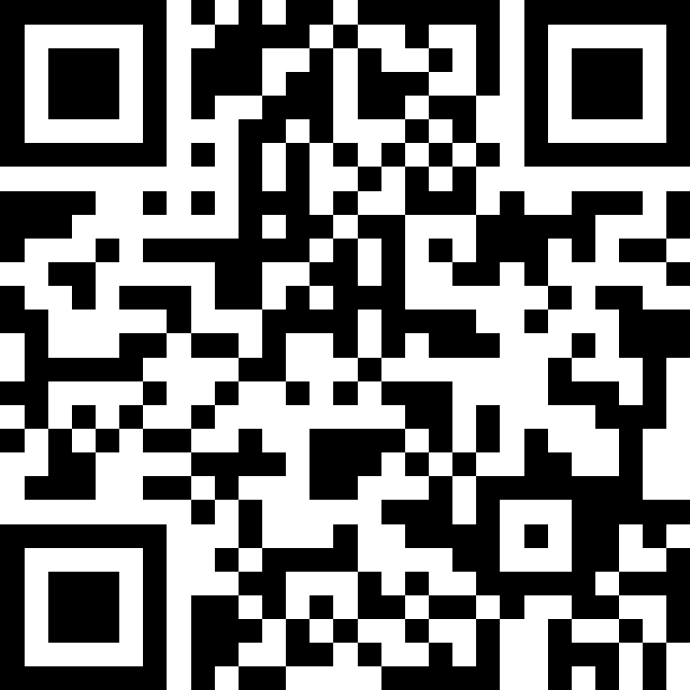
Before we start · phones out
Where are you with AI?
The Googler — I use it like a faster search engine
A
SCAN
The Collaborator — I give it context and push back
B
The Operator — I have systems that run without me
C
Please respond honestly
I have barely used it
D
WaterMeetSky · Exness Partner Workshop · Part 1
4

Slide 8
SCAN
Please respond honestly
WaterMeetSky · Exness Partner Workshop · Part 1
4

Slide 9
Framework
Three levels of AI use
Goal today: move everyone up at least one level.
01 The Researcher
02 The Collaborator
03 The Operator
You ask questions. It gives answers. Used like a faster search engine. Output is generic because input is generic.
You give it context about your business. You correct it and push. Output starts to sound like you.
You build systems that run parts of the business without you. This is the level the day is built for.
WaterMeetSky · Exness Partner Workshop · Part 1
5

Slide 10
A following is not
a client base.
You have already done the hard part. People are watching.
WaterMeetSky · Exness Partner Workshop · Part 1
6

Slide 11
The current picture
What is working, and where it leaks
What partners do well
Where the business leaks
– Build large audiences quickly
– Posting is inconsistent and unplanned
– Generate high volumes of enquiries
– Branding looks like an individual
– Understand the product and the market
– Enquiries go unanswered or late
– Create content when motivated
– No record of who the audience is
WaterMeetSky · Exness Partner Workshop · Part 1
7

Slide 12
The principle
Look like an engine,
not a one-person shop.
A partner who appears consistently, communicates professionally and responds quickly looks like a company with a team. That perception earns trust. AI is what lets one person operate at that standard.
01
02
03
04
Attract
Capture
Convert
Retain
Positioning, brand and content that makes people notice and trust you.
Turning attention into contact details and information you own.
Fast, personalised follow-up that moves people to open and fund.
Education and community that keeps clients active over time.
this morning
this morning
after lunch
after lunch
WaterMeetSky · Exness Partner Workshop · Part 1
8

Slide 13
Positioning first.
Decide who you are before you decide what to post.
WaterMeetSky · Exness Partner Workshop · Part 1
9

Slide 14
Write these down
Four questions you must answer
01
Who exactly do you serve?
Not “traders”. Experience, age, job, situation.
02
What do you promise them?
The one outcome they get from following you.
03
What is your tone?
Three words. Calm. Practical. Honest. beats “professional yet relatable”.
04
What are your three pillars?
The three subjects you post about every week. Everything else is a guest.
WaterMeetSky · Exness Partner Workshop · Part 1
10

Slide 15
Live build
Positioning prompt
You are a brand strategist. I am an Exness introducing broker based in Ghana. Ask me three questions first: who my ideal trader is, which platform I use most, and how I like to communicate.
Then give me:
1. A one-line positioning statement
2. The promise I make to my audience
3. My tone of voice in three words
4. Three content pillars I should post about every week
Keep everything specific to the Ghanaian market.
What good looks like
I help working Ghanaians in their late twenties and thirties learn to trade properly, without quitting their jobs.
Promise: understand it before you risk real money.
Tone: Calm. Practical. Honest.
Pillars: risk, simple market basics, lessons from the week.
WaterMeetSky · Exness Partner Workshop · Part 1
11

Slide 16
Visual identity
People decide if you are credible before they read a word.
01
02
03
04
05
Colour set
Font pairing
Wordmark
Four templates
Caption format
Two mains, one accent. Stop there.
One for headings, one for body.
Same profile image everywhere.
Update, teach, insight, promote.
A writing pattern people recognise.
Different colours every post = an individual improvising. Same identity = an organisation with standards.
WaterMeetSky · Exness Partner Workshop · Part 1
12

Slide 17
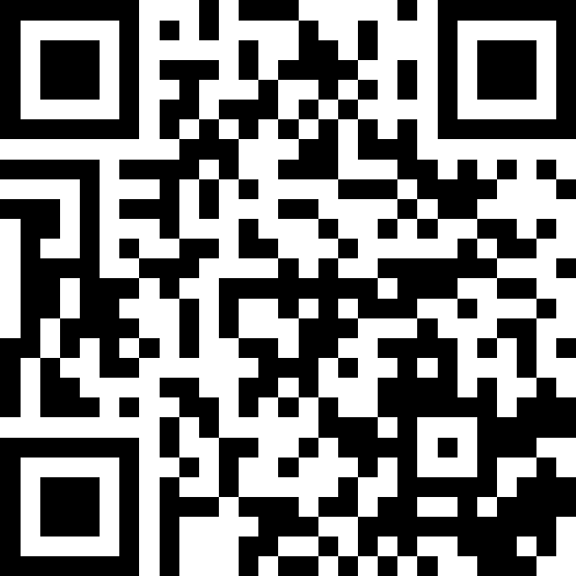
Quiz 1 ·
Which partner would you trust with your own money?
SCAN
A
B
Posts daily, then disappears for a month
Only posts winning trades
C
D
Please respond honestly
Same slot every week — including losses
Has the most followers
WaterMeetSky · Exness Partner Workshop · Part 1
13

Slide 18
SCAN
Please respond honestly
WaterMeetSky · Exness Partner Workshop · Part 1
4

Slide 19
Quiz 1 · The point
Consistency beats volume.
Rhythm reads as a business
Selective honesty is detected
Volume without a schedule reads as desperation.
Posting only wins damages credibility. People notice the missing losses.
Follower count is the weakest signal
The algorithm agrees
It is the number people quote and the one they trust least with money.
Platforms distribute accounts that show up. Not accounts that spike and vanish.
WaterMeetSky · Exness Partner Workshop · Part 1
14

Slide 20
Content scenario
A useful reason to come back
A member asks about trading costs.
AI prepares a short lesson, a video script
and a question that checks understanding.
Their experience shapes the explanation.
Your voice stays consistent.
You review the facts before publication.
Try /journey engage. Then build the content engine that follows.
WaterMeetSky · Exness Partner Workshop · Client journey
J3
Notes:
Run the education workflow with topic costs and experience new, then experienced. Compare the depth. Use the saved reviewed output if the model is unavailable. This makes the existing content multiplication and positioning blocks commercially concrete. Do not claim a lesson causes more trading or commission. Workshop hub: https://workshop.wms.africa/journey . Samples are fictional. The browser uses saved, reviewed AI outputs; /journey CASE uses live AI privately for the partner. The downloadable follow-up flows end in review, not automatic customer broadcasts. Preserve the complete existing teaching block that follows.

Slide 21
One idea.
Used everywhere.
The problem is rarely ideas. It is producing them from a blank page.
WaterMeetSky · Exness Partner Workshop · Part 1
15

Slide 22
Content engine
One insight, four channels
Insight
X + Video
Telegram + WhatsApp
Discipline produces better long-term results than accuracy.
A thread on why being right half the time can still pay. A 45-second script that opens on risk, not analysis.
A short lesson with one action for the week. A personal check-in with one practical tip. Not an essay.
WaterMeetSky · Exness Partner Workshop · Part 1
16

Slide 23
Live build
Content multiplication prompt
Use my brand profile below as context.
[PASTE YOUR POSITIONING AND BRAND PROFILE]
Take this insight and turn it into a week of content for a Ghanaian audience.
Insight: [PASTE YOUR INSIGHT]
Produce:
1. One X thread of five posts
2. One 45-second video script with a strong opening line
3. One Telegram post
4. One WhatsApp broadcast message
Keep the tone consistent with my brand profile. End each with a clear next step. No guaranteed-return language.
WaterMeetSky · Exness Partner Workshop · Part 1
17

Slide 24
Social growth
What platforms actually reward
Consistency
Topic focus
Early engagement
Regular publishing signals an account worth distributing.
They must understand what you are about before they can recommend you.
The first hour decides how far a post travels.
Retention
Native formats
A plan and a theme
How long people stay matters more than how many see it.
Built for the platform beats copied across platforms.
If somebody cannot describe you in one sentence, neither can the algorithm.
WaterMeetSky · Exness Partner Workshop · Part 1
18

Slide 25
Calendar
A calendar that runs without you
01
Fix the days
Decide posting days and formats once. Not every Sunday night.
02
Assign pillars
Each day maps to one of your three content pillars.
03
Generate four weeks
One sitting. Ideas first, production second.
04
Batch produce
Write and design in blocks. The single biggest time saver.
05
Review monthly
Adjust against what performed. Patterns need volume.
WaterMeetSky · Exness Partner Workshop · Part 1
19

Slide 26
Live build
Four-week calendar prompt
Using my brand profile and my three content pillars, build a four-week content calendar.
For each week give me:
1. One educational post explaining a concept simply
2. One post addressing a common mistake
3. One post building a habit or discipline
4. One engagement post that invites a reply
For each item give a title, a one-line summary and the best platform for it.
Audience: Ghanaian traders, mostly beginners.
WaterMeetSky · Exness Partner Workshop · Part 1
20

Slide 27
Make it sound
like it came from here.
Generic content is the default failure. Local context is the edge.
WaterMeetSky · Exness Partner Workshop · Part 1
21

Slide 28

Localisation
Same fact. Different register.
IMPORTED
FROM HERE
The market experienced significant volatility today. Below is a detailed breakdown of the price action.
The market moved sharply today. Here is what happened, explained simply.
Khaya AI
How you use it
The rule
Ghana NLP*. Twi, Ga, Ewe, Dagbani, Pidgin, it can do the translation, the transcription, and voiceovers.
Voiceovers on short video. Educational posts in the language the group actually speaks.
Test with a native speaker before you publish. Accuracy protects credibility.
WaterMeetSky · Exness Partner Workshop · Part 1
22

Slide 29
Recap · first half
Five moves so far
One
Positioning decided before any content is produced.
Two
One visual identity, applied consistently.
Three
A production line: one idea into a week of content.
Four
A calendar built four weeks ahead, on three pillars.
Five
Local language and register as a commercial advantage.
WaterMeetSky · Exness Partner Workshop · Part 1
23

Slide 30
Break.
15 minutes. We resume with lead generation and data.
WaterMeetSky · Exness Partner Workshop · Part 1
24
Notes:
Give a firm return time and start on it.
Give a firm return time and start on it.

Slide 31
Capture scenario
One enquiry becomes a usable record
The prospect gets the promised checklist.
The form records the source and intent.
The bot continues the conversation.
Their reply shapes the next step.
Identity review protects private records.
Exness confirms available attribution.
Watch a fictional phone submission appear in the private sheet.
WaterMeetSky · Exness Partner Workshop · Client journey
J4
Notes:
Use the existing live Google Form and linked response sheet. Show only fictional workshop rows. The form confirmation links to Telegram. /start form waits for a synced record and asks for bot consent. A form/email match does not verify identity. Source: https://my.exnessaffiliates.com/api/schema/ . Workshop hub: https://workshop.wms.africa/journey . Samples are fictional. The browser uses saved, reviewed AI outputs; /journey CASE uses live AI privately for the partner. The downloadable follow-up flows end in review, not automatic customer broadcasts. Preserve the complete existing teaching block that follows.

Slide 32

WhatsApp is a channel.
It is not a database.
If the phone gets blocked, the business dies with it.
WaterMeetSky · Exness Partner Workshop
2

Slide 33





You have a crowd.
Not a database.
If the platform disappears tomorrow, so does your audience.
WaterMeetSky · Exness Partner Workshop · Part 1
25

Slide 34
Capture
People do not “store data”.
They trade it.
01
02
03
The offer
The form
The habit
A checklist, a 15-minute briefing, a Twi voice note, a seat on tonight’s live. Something they want more than they fear the form.
Four fields only: name, WhatsApp number, have you traded, what do you want to learn. Everything else comes later.
Every post, video, live and Telegram pin ends on the same link. One door. Not five.
WaterMeetSky · Exness Partner Workshop
3

Slide 35
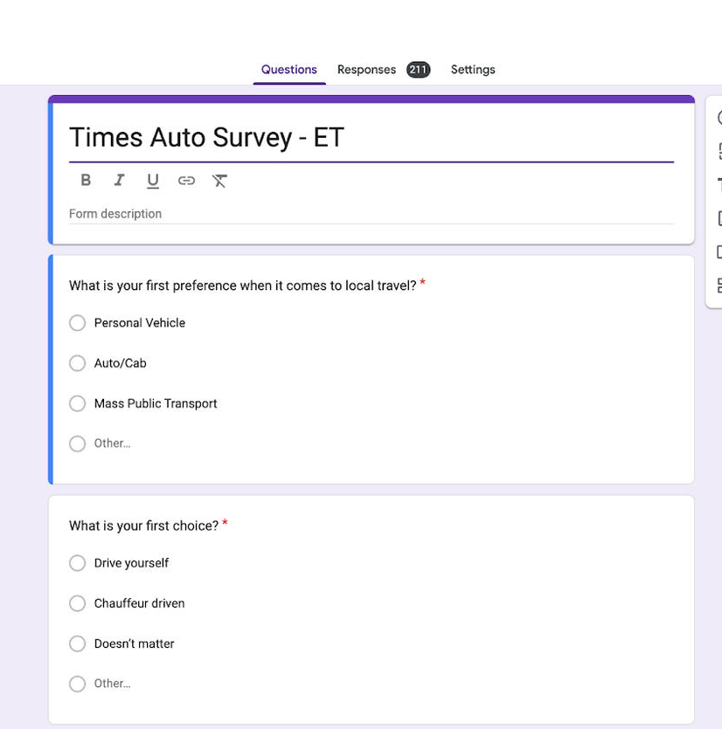
The door
This is the first real tool.
Free. Works on a Tecno. Writes itself into a Sheet. No partner in this room needs a developer to open a door.
01 Link in bio, pinned Telegram post, end of every video.
02 Short link: bit.ly / TinyURL. Brand it a special closed community
03 Thank-you page = WhatsApp or Telegram bot, not a dead screen.
04 Turn on email notifications so a lead is not sitting overnight.
WaterMeetSky · Exness Partner Workshop
4

Slide 36
CRM
A spreadsheet is a legitimate CRM.
One row per person
Status
Last-contact date
Form → sheet
One column per thing you need to know.
New · Contacted · Opened · Funded · Active · Dormant
This column tells you who is being neglected.
Entries arrive automatically. No copy-paste.
WaterMeetSky · Exness Partner Workshop · Part 1
28

Slide 37
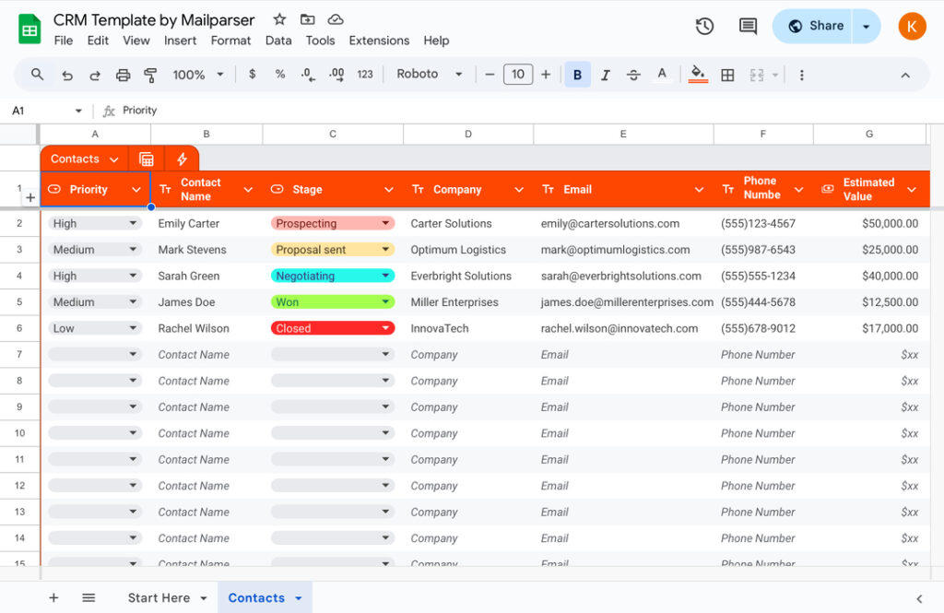
The first CRM · Google Sheets
A sheet with stages is a CRM.
Columns that matter
Date in
Name
Phone
Source
Intent 1–5
Stage
Last touch
Next action
Notes
WaterMeetSky · Exness Partner Workshop
5

Slide 38
When the sheet starts to hurt
Leave the sheet when the sheet fights you.
NOW
NEXT
THEN
LATER
Google Sheets
Airtable
HubSpot Free
Kommo / Bitrix
Under 200 names. One person. Filter by stage every morning.
Views, attachments, a form that looks less like homework. Still cheap.
Pipeline, tasks, email log. When two people touch the same leads.
WhatsApp and Telegram live inside the deal card. Only when volume justifies it.
WaterMeetSky · Exness Partner Workshop
6

Slide 39
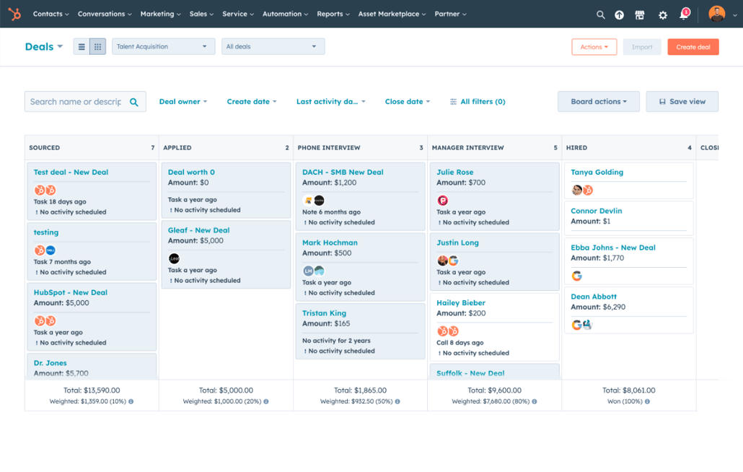
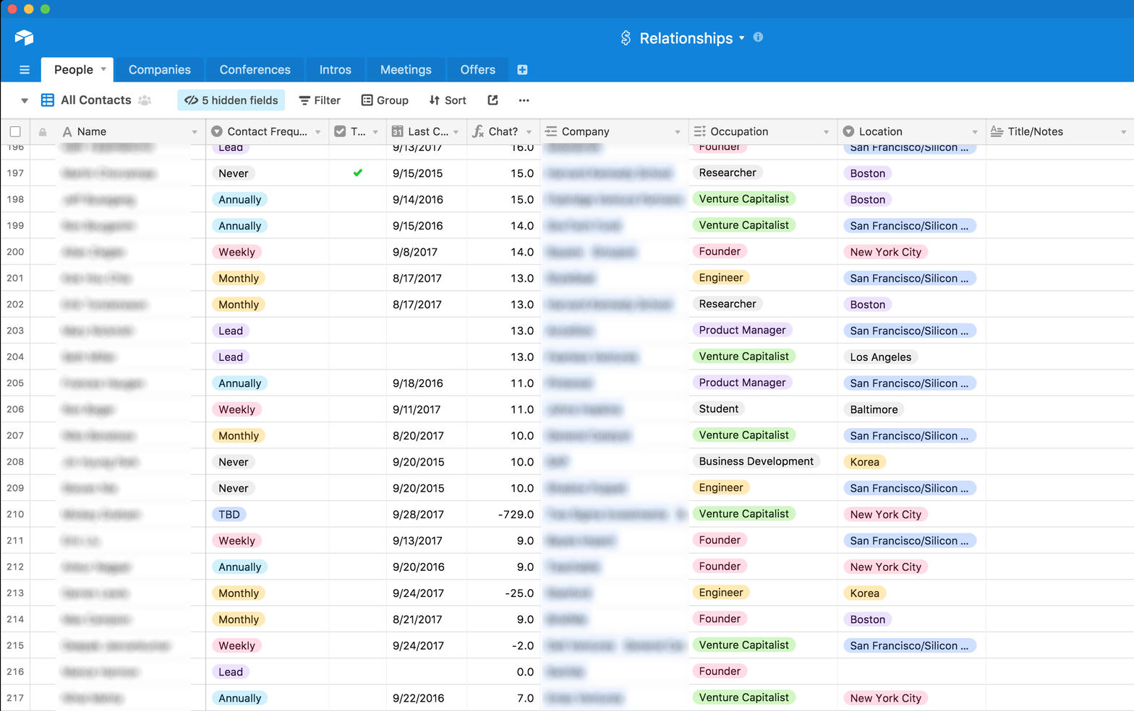
What “grown-up” looks like
HubSpot pipeline · Airtable table
WaterMeetSky · Exness Partner Workshop
7

Slide 40
Capture
Six fields. No more.
Name
Phone
Email
Personalised messages outperform generic ones.
Direct contact you own, independent of any platform.
For longer content and anything the apps restrict.
What they want to trade
Experience level
Source
Relevance instead of broadcasts.
Tells you whether to educate or advise.
Which channel is actually producing clients.
WaterMeetSky · Exness Partner Workshop · Part 1
26

Slide 41
The exchange
How people actually give you their details
Offer something specific
A guide, a checklist, a session. Vague “join my list” does not convert.
Make it immediate
People give details when they get something now.
Keep the form simple
Google Forms is enough. Connected to a sheet.
Put the link everywhere
Bio, pinned post, group description, captions.
Ask at peak interest
Right after the useful post. Not three days later.
WaterMeetSky · Exness Partner Workshop · Part 1
27

Slide 42
Quiz 2
Which piece of information is most valuable six months from now?
A Name
B Phone number
C What they want to trade — and why
D Email
WaterMeetSky · Exness Partner Workshop · Part 1
29

Slide 43
Quiz 2 · the point
Contact details reach people.
Intent converts them.
By stage
By interest
By experience
By source
New, in conversation, opened, funded, active, dormant.
What instruments they asked about.
Beginner, some experience, already trading.
Which platform or campaign brought them in.
Four segments is enough. Do not build twenty.
WaterMeetSky · Exness Partner Workshop · Part 1
30

Slide 44
Qualification scenario
The right next step for this person
Ask about experience and learning goals.
Find out whether they want a resource
or a conversation with the partner.
AI helps interpret the stated need.
The API supplies recorded milestones.
The partner handles sensitive questions.
Lead qualification and Exness CPA qualification are separate checks.
WaterMeetSky · Exness Partner Workshop · Client journey
J5
Notes:
Try /journey welcome and /journey qualify. Show the qualification-card CSV. The implemented client-report integration checks attribution and available KYC/first-deposit/first-trade flags. Those flags alone do not prove CPA qualification. This is self-declared lead fit, not an affordability assessment or a prediction of profitable clients. Source: https://get.exness-affiliates.help/hc/en-us/articles/360016773680-How-to-become-a-Digital-Affiliate-DA . Workshop hub: https://workshop.wms.africa/journey . Samples are fictional. The browser uses saved, reviewed AI outputs; /journey CASE uses live AI privately for the partner. The downloadable follow-up flows end in review, not automatic customer broadcasts. Preserve the complete existing teaching block that follows.

Slide 45
Live build · highest-value workflow today
Lead scoring prompt
Below is a list of enquiries from the past week, including what each person asked about and how they responded.
[PASTE YOUR LIST]
For each person:
1. Score their intent from 1 to 5 and explain the score in one line
2. Tell me which segment they belong to
3. Draft the next message I should send, friendly and honest, with no promises of guaranteed returns
Then list the five people I should contact first today.
WaterMeetSky · Exness Partner Workshop · Part 1
31

Slide 46
Part 1 · you now have
The engine, on paper.
1
Who you are — positioning, promise, tone, three pillars
2
How you look — one identity, applied consistently
3
How you publish — a production line and a four-week calendar
4
Who you own — a capture form and a working CRM
5
Who to call first — segments and a scoring workflow
WaterMeetSky · Exness Partner Workshop · Part 1
32

Slide 47
Lunch.
After lunch: converting those contacts
into funded, active clients.
WaterMeetSky · Exness Partner Workshop · Part 1
33

Slide 48
Recap
Where we are
Attract
Capture
Convert
Retain
Positioning, identity, content, social.
Forms, data, a working CRM.
Fast, personalised follow-up.
Verification, community, education.
done
done
now
next
WaterMeetSky · Exness Partner Workshop · Part 2
1

Slide 49
Follow-up scenario
A message that fits the actual step
Verification still unrecorded?
Offer help with the official instructions.
Verification recorded? Move on.
A fresh API check selects the stage.
AI drafts the relevant reply.
A person reviews contact permission.
Switch the sample KYC flag in the Journey Lab and watch the next step change.
WaterMeetSky · Exness Partner Workshop · Client journey
J6
Notes:
Try /journey onboarding. Use the browser simulator to mark KYC recorded. The next step changes to optional orientation rather than another verification reminder. In the real workflow, refresh one independently verified consenting record through /journey/check. API reads can fail or lag. The model cannot complete KYC, open accounts, fund accounts or declare CPA qualification. Workshop hub: https://workshop.wms.africa/journey . Samples are fictional. The browser uses saved, reviewed AI outputs; /journey CASE uses live AI privately for the partner. The downloadable follow-up flows end in review, not automatic customer broadcasts. Preserve the complete existing teaching block that follows.

Slide 50
Most enquiries are not
lost to competitors.
They are lost to silence.
WaterMeetSky · Exness Partner Workshop · Part 2
2

Slide 51
Follow-up
Build the answers before you automate
01
02
03
04
05
List the repeats
Write one honest answer
Local versions
Review for compliance
Reuse everywhere
Usually fewer than fifteen questions.
Short. Your voice. No income claims.
At least the most common three.
Before anything is automated.
Bot, replies, FAQs, content.
WaterMeetSky · Exness Partner Workshop · Part 2
3

Slide 52
Live build
Answer bank prompt
List the 10 questions a new prospect most often asks an Exness partner in Ghana before they open and fund an account.
For each question write a short, honest answer:
1. No more than three sentences
2. Friendly and clear, in plain English
3. No promises of guaranteed profit and no income claims
4. Include a realistic mention of risk where relevant
Then rewrite the three most common answers in Pidgin.
WaterMeetSky · Exness Partner Workshop · Part 2
4

Slide 53
The always-on responder
Respond immediately. Pass the serious ones to you.
1 Channel
2 Greet
3 Bank
WhatsApp Business or Telegram — wherever enquiries already arrive.
Acknowledge the person by name where you can.
Common questions handled without you.
4 Qualify
5 Route
6 Log
What they want to trade. Whether they have traded before.
Serious answers go straight to you, attached.
Every conversation into this morning’s sheet.
WaterMeetSky · Exness Partner Workshop · Part 2
5

Slide 54
Tools
Start no-code. Go further only if you build.
Start here
If you build
WhatsApp Business quick replies and away messages.
ManyChat, Chatfuel or Landbot for guided flows.
Built in an afternoon. Handles most routine enquiries.
Most of the room belongs here.
An AI-backed bot that understands free text.
Connected through Make or n8n to your CRM.
Telegram bots on available APIs.
Local language via the Khaya API.
WaterMeetSky · Exness Partner Workshop · Part 2
6

Slide 55
Personalisation
Broadcasts are efficient. They are also ignored.
Write once
Use the form data
Stay useful
Keep it honest
One core message. Then a version per segment.
Reference what the person actually told you.
Regular and useful beats occasional and promotional.
No guaranteed returns. One clear next step.
WaterMeetSky · Exness Partner Workshop · Part 2
7

Slide 56
Live build
Segmented follow-up prompt
I want to send an update to my contact list about [TOPIC].
Write a separate version for each of these segments:
1. New enquiries who have not opened an account
2. People who opened an account but have not funded it
3. Active clients trading regularly
4. Dormant clients who have gone quiet
Each message should be short, personal and honest, with a single clear next step. No guaranteed return claims. Keep the tone consistent with my brand profile.
WaterMeetSky · Exness Partner Workshop · Part 2
8

Slide 57
You already own
the verification tool.
Most partners do not know it exists.
WaterMeetSky · Exness Partner Workshop · Part 2
9

Slide 58
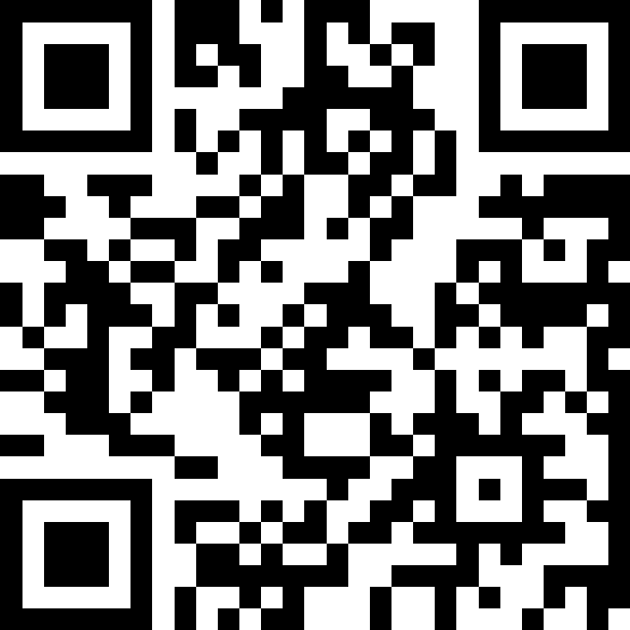
SCAN
Please respond honestly
WaterMeetSky · Exness Partner Workshop
4

Slide 59
Quiz 3
Have you used the partner tool that verifies people in your group are still your clients?
A Yes — linked to my Telegram
B I know it exists but never set it up
C I have never heard of it
D I thought it was only for paid communities
WaterMeetSky · Exness Partner Workshop · Part 2
10

Slide 60
Verification
Why this is commercial, not admin
Already yours
Confirms attribution
Protects the work
In the partner back office. Every partner has access.
Is this person actually your client, or just in the group?
Access depends on remaining an active client.
Improves the CRM
Supports retention
Before the day
Verification status becomes another column in this morning’s sheet.
Members have a concrete reason to stay active.
Get a demo login. Confirm the name. Do not present this from memory.
WaterMeetSky · Exness Partner Workshop · Part 2
11

Slide 61
Engagement scenario
Support continues after onboarding
Useful lessons answer the questions
people actually ask. Human support
handles the problems that remain.
After a gap in conversation, ask
whether help, a lesson or a pause
would be useful. Respect the answer.
Try /journey return, then /journey stop.
WaterMeetSky · Exness Partner Workshop · Client journey
J7
Notes:
The conversation-gap demo uses the bot's last recorded inbound message, not trading-account inactivity. The checked client report has a first-trade flag but no complete current activity history. Never claim someone stopped trading or lost money from these fields. Ongoing support is commercially relevant to an IB, but it must not pressure trading to earn commission. The re-engagement template produces a review queue. Workshop hub: https://workshop.wms.africa/journey . Samples are fictional. The browser uses saved, reviewed AI outputs; /journey CASE uses live AI privately for the partner. The downloadable follow-up flows end in review, not automatic customer broadcasts. Preserve the complete existing teaching block that follows.

Slide 62
Retention is where
income is decided.
None of these are trading problems. All of them are communication problems.
WaterMeetSky · Exness Partner Workshop · Part 2
12

Slide 63
Why clients go quiet
Four reasons. None of them are the market.
They lost money early
They never understood it
You went quiet first
The group became a pitch
And had nobody explaining what happened.
So confidence never developed.
Contact stopped once the account opened.
Promotional rather than useful.
WaterMeetSky · Exness Partner Workshop · Part 2
13

Slide 64
Weekly series
One slot. Three pieces. Every week.
Concept
Mistake
Habit
One idea explained simply.
One common error to avoid.
One discipline to build.
Fix the day. Keep each piece short. Produce a month at a time with AI, then schedule it. Consistency matters more than depth.
WaterMeetSky · Exness Partner Workshop · Part 2
14

Slide 65
Live build
Four-week education series prompt
Design a four-week educational series for my trading community.
Each week contains three short pieces:
1. One concept explained simply
2. One common mistake to avoid
3. One habit or discipline to build
For each piece give a title and a one-line summary.
Audience: Ghanaian traders, mostly beginners. Keep it honest and practical, with realistic risk framing and no guaranteed return claims.
WaterMeetSky · Exness Partner Workshop · Part 2
15

Slide 66
Segments
Different people need different messages
New members
Not yet funded
Active clients
Gone quiet
Orientation. What to expect, how to ask, where to start.
Reassurance. Remove the specific blocker.
Depth. Market context, their actual questions.
A human check-in. No pitch. Ask what happened.
WaterMeetSky · Exness Partner Workshop · Part 2
16

Slide 67
Break.
10 minutes. We come back to build something together.
WaterMeetSky · Exness Partner Workshop · Part 2
17

Slide 68
Live business challenge
One journey you can run on Monday
Choose a prospect and a real question.
Build the welcome and next-step rule.
Prepare one follow-up and one lesson.
State which API evidence you need.
Show what happens if it is missing.
Choose one outcome to measure.
Download the workflows, prompts and editable messages at workshop.wms.africa/journey
WaterMeetSky · Exness Partner Workshop · Client journey
J8
Notes:
Keep the original group challenge and worksheet that follow. Add these checks to the demonstration: identity before private account access, lead fit versus CPA status, stale-data hold, stop on opt-out and human handoff. Use one of the five reusable flows rather than implementing everything. Budget 25 minutes as already planned. Workshop hub: https://workshop.wms.africa/journey . Samples are fictional. The browser uses saved, reviewed AI outputs; /journey CASE uses live AI privately for the partner. The downloadable follow-up flows end in review, not automatic customer broadcasts. Preserve the complete existing teaching block that follows.

Slide 69
Apply it.
25 minutes. One real partner business. A working system.
WaterMeetSky · Exness Partner Workshop · Part 2
18

Slide 70
Challenge
What each group produces
1
A positioning statement and three content pillars
2
One content idea, expanded into three platform-specific posts
3
A lead-capture offer, and the six fields on the form
4
The first automated reply a new enquiry receives
5
One weekly series concept for the community
WaterMeetSky · Exness Partner Workshop · Part 2
19

Slide 71
Standards
What damages trust fastest
Disappearing
Posting intensively, then going silent for weeks.
Selective reporting
Showing only winning trades. Audiences recognise it.
Income claims
Promising returns is dishonest and a risk to partner status.
Ignoring people
Leaving enquiries unanswered while asking for deposits.
Borrowed credibility
Rented status symbols. Transparent. Wrong clients.
WaterMeetSky · Exness Partner Workshop · Part 2
20

Slide 72
Live habit
Compliance check prompt
Review the marketing content below as a compliance reviewer for a financial services brand.
[PASTE YOUR CONTENT]
Identify:
1. Any implied or explicit promise of profit or guaranteed returns
2. Any claim that cannot be substantiated
3. Anything that understates risk
4. Anything that could mislead a beginner
Then rewrite the content so it remains persuasive but removes each issue.
WaterMeetSky · Exness Partner Workshop · Part 2
21

Slide 73
Next 30 days
Build one week at a time
Week 1
Week 2
Week 3
Week 4
Finish positioning and identity. Publish on a fixed schedule.
Put the capture form live. Record every contact.
Automated first response and the answer bank.
Launch the weekly series. First segmented follow-up.
WaterMeetSky · Exness Partner Workshop · Part 2
22

Slide 74
To recap
The systems you now have
One
Positioning, identity, a content production line.
Two
A four-week calendar aligned to three pillars.
Three
A capture form and a working CRM.
Four
An automated first response and a scoring workflow.
Five
A retention series, segmented comms, verification.
WaterMeetSky · Exness Partner Workshop · Part 2
23

Slide 75
You have already
built the audience.
Now build the business behind it.
WaterMeetSky · Exness Partner Workshop · Part 2
24

Slide 76

WMS DIGITAL
THE FUTURE, FASTER
Our strategy and digital experts help our clients grow revenue and drive results with in depth execution, proven process, and the most experienced digital strategy team
Learn more
Start your strategy
WaterMeetSky Company Limited | Reg No: CS024210223 | Trading as WMS DIGITAL | wms.africa

